Slide 1
Script choice for sustainable language development: A case study from Ethiopia
Tefera Endalew SIL- Ethiopia
Tefera_endalew@sil.org

Slide 3
Ethiopia
The population is 78 million
Diverse linguistic and ethnic community
87+ indigenous languages
9 regional states and 2 city administrations.
each region chooses its regional language
Language communities are backed by the constitution and Education policy.

Slide 4
Constitutional right
“Every Nation, Nationality and People in Ethiopia has the right to speak, to write, and to develop its own language; to express, to develop, and to promote its culture, and to preserve its history”( Article 39 Rights of Nations..)
Regions chose their working language (Afar, Oromiya,Tigria, Somili,Amara,Harari
The Federal working language is Amharic.
Amharic is also a regional working language of ethnically diverse regions ( SNNPRS, BG,Gambela, Addis Abeba, Derdawa)

Slide 5
Education Policy
“Cognizant of the pedagogical advantage of the child in learning in mother tongue and the rights of nationalities to promote the use of their languages, primary education will be given in nationality languages.” (The Education and Training Policy, point 3.5.1)
Amharic is taught as a language of countrywide communication.
English is the medium of instruction for secondary and higher education and taught as a subject from grade one
Students can choose and learn at least one nationality language and one foreign language for cultural and international relations.

Slide 6
Orthography development.
Historically many of the languages were written in Ethiopic script (for a literacy campaign, Bible translation)
Since 1992, two scripts have been used to write Ethiopian languages:-
Ethiopic ( Amahric,Ge’ez, Sabian)
Roman (Latin)
There is no official policy on which script should be used to write Ethiopian languages but it is believed that all Semitic language families should use Ethiopic
Since 1992 the predominant approach for language development was top down with very few exceptions (korete)
Script choice in the country carries political, social, historical and sometimes religious connotations!

Slide 7
Language use
More than 24 languages out of 87 are currently used either as a medium of instruction or as a subject in school.
Some regions use mother tongue as MOI from grade 1-4(SNNPRS exception Keffinano) then transfer to English as MOI, some others use MT as MOI up to grade 8 and then transfer to English (Oromia)
Since 1992, 14 languages out of the 57 languages of the southern region have implemented mother tongue education.

Slide 8
The Bench Maji zone community
South west Ethiopia, under the regional administration of SNNPRS
Six ethnic minority groups.
Total population 659,046
Nomad, semi- nomadic and agriculturalist community
Two languages families ( Omotic and Nilo-Saharan)
Bench, 353,526
Diizi, 36,380
Sheko, 37,573
Me’en, 151,489
Suri, 27,886
Baale, 2,704.

Slide 9
Educational challenge
All the six languages were mainly oral except for some use in protestant church literacy programs.
Education is given in children's second language (Amharic)
Class repetition is high at all grade levels.
High drop out ( grade 5 and 8) Because of medium of instruction and the national exam.17th annual education report of the zone 2011
Poor infrastructures and sometimes ethnic conflicts for decades but a drastic improvement in recent years.

Slide 10
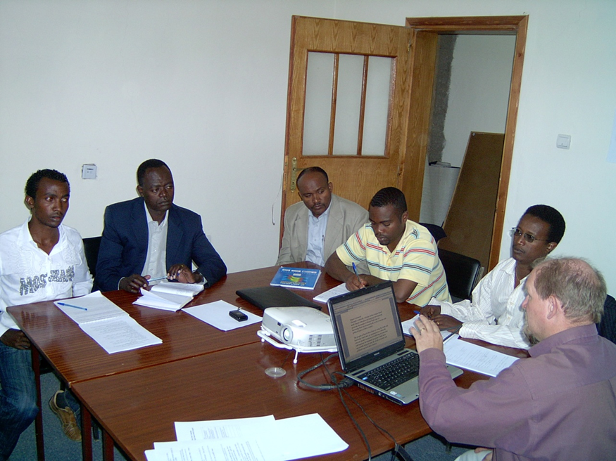
Meeting the challenge
SIL was invited by the zone administration to help in MTE and language development for the six languages
a joint committee was formed for planning:
SIL team
zone education
Zone culture and information
Mizan Tapi university
Local and regional NGO representatives
Religious organization representatives

Slide 11
Implementation structure
In 2008 a multi-level Board of Language Committees was established in order to carry out awareness , script choice, funding, curriculum development and monitoring the progress of the program at all levels .
At zone level, the Board is chaired by the chief official of the zone with 11 members who are zonal government officials
Assisted by a technical team consisting of a project manager, a curriculum development specialist and an administrator.
13 staff, two or three of whom come from each of the six language groups of the zone
At the Woreda level (11) woredas in the zone, the structure of the Committee is the same, consisting of the local government officials .
likewise at the lowest administrative area of the kebele.

Slide 12
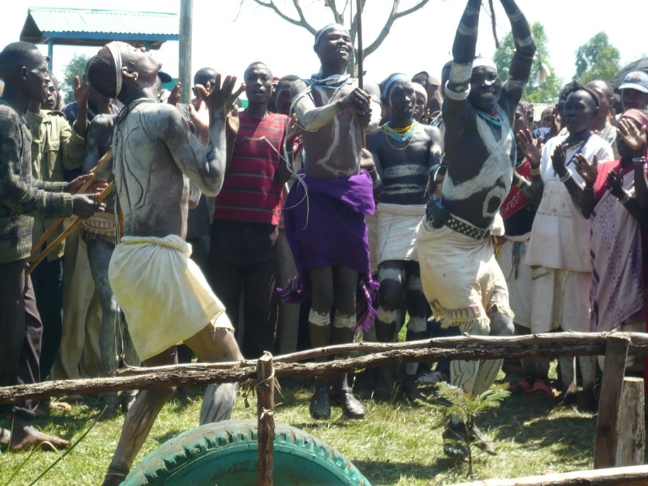
Implementations (cont.)
35% of the project is covered by the local government, 13 staff members are paid
65 % of the budget comes from SIL

Slide 13
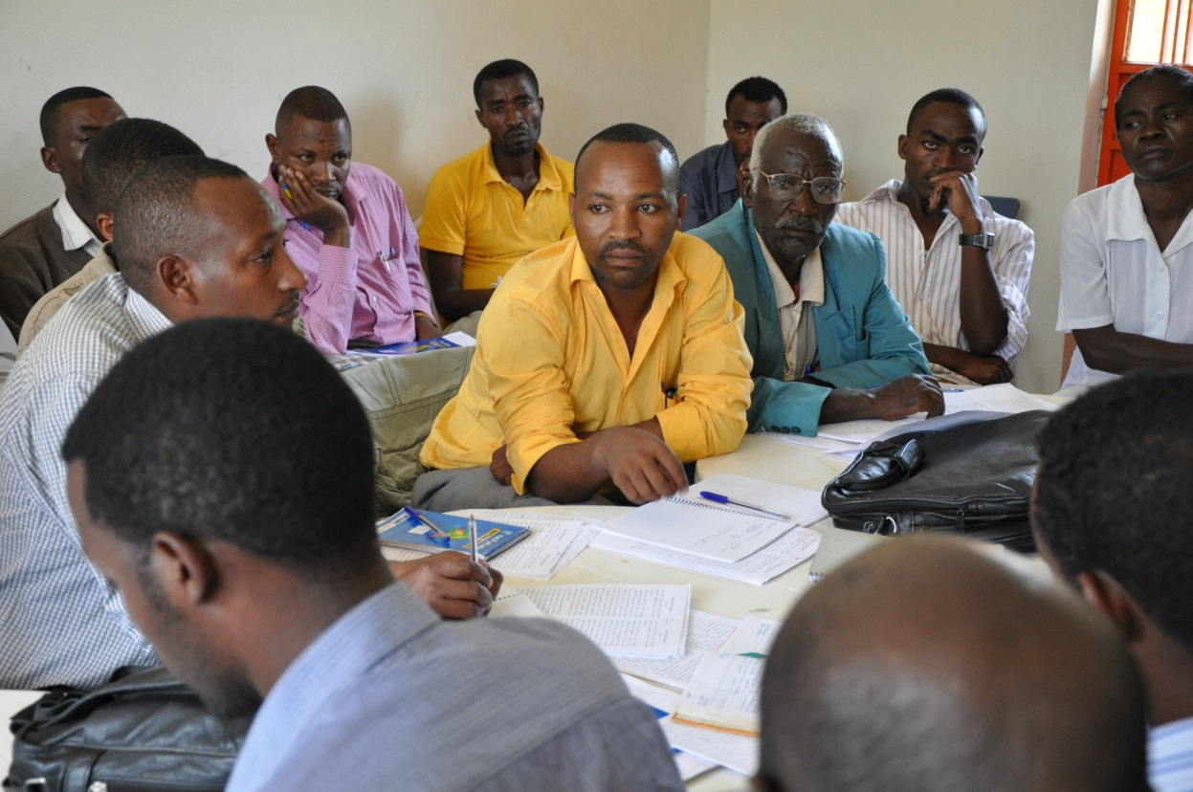
Orthography workshops
Linguistic research Grammar and phonology of the language
2 weeks writers workshops for different dialects in two scripts Ethiopic and Roman

Slide 14
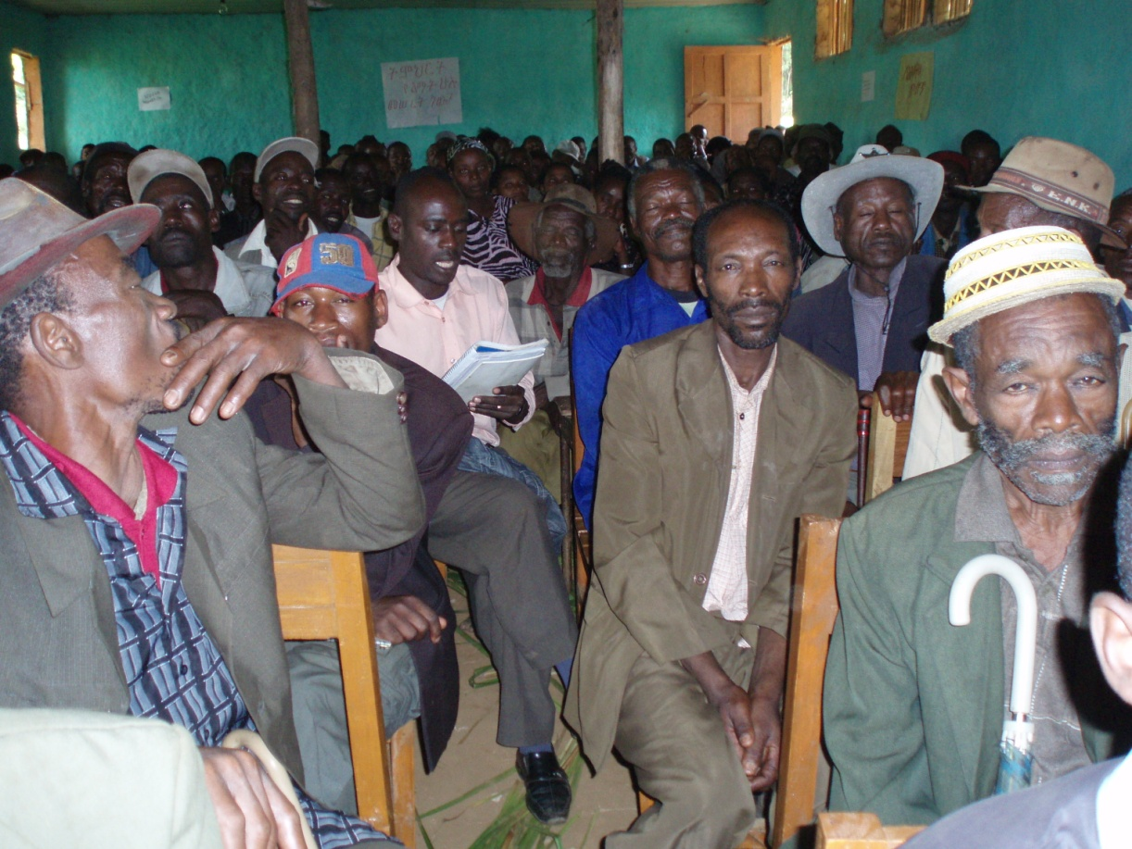
Script Decision ስክሪፕት ዴሲዥን
Call a two day conference for script choice
every village and dialect from high level to the grass root structure of government NGOs, religious representatives
The main linguist and the local literacy teachers will present the vowels and consonants of the language in both scripts.

Slide 15
Script Decision
Informed choices by the language community with advantages and disadvantages of each option
Explanations and rationale for each design feature
አ ባ ቱ ነ ገ ላ ም ይ ገ ዛ ል
ʼ a b: a t u n ɛ g ɛ l a m yə g ɛ z a l:
የእብራእስትን አልፋቤት אַבָתו נֶגֶ לָמ יִגֶזַל
Geraman Abbahtu nägä lahm jigäsal
(Tefera and Achim 2007)

Slide 16
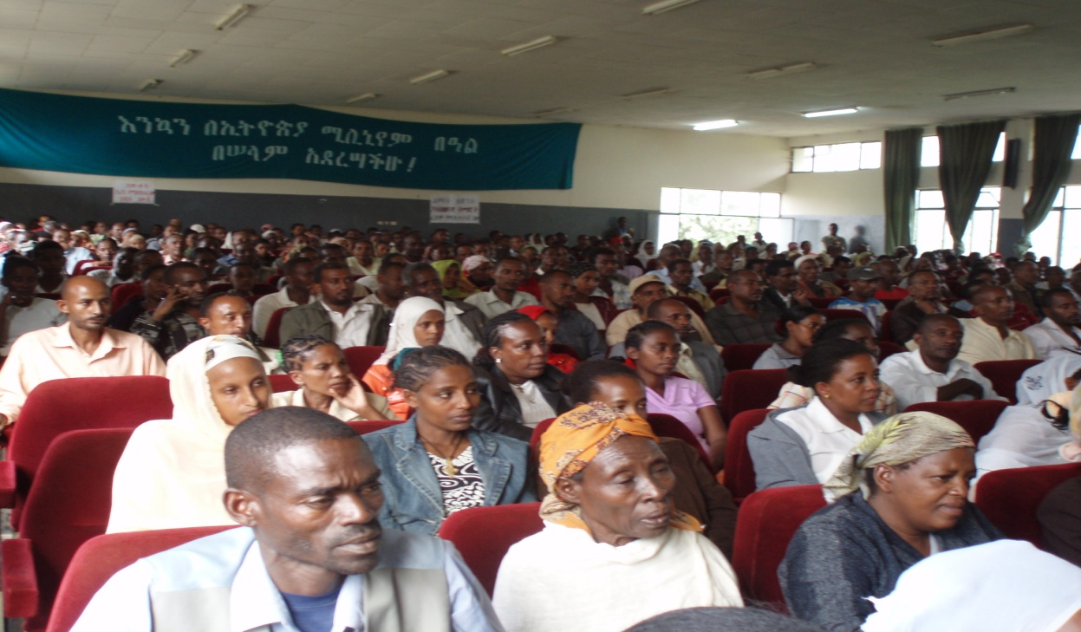
advantages and disadvantages of each script option will be discussed from the point view of Educational benefit, sociolinguistics, historical/political
Short traditional stories will be read in both scripts and the participants will have a chance to read in both scripts and see materials that are available in two scripts ( produced for these events)
The second day will
be fully dedicated to
discuss the advantages
and disadvantages
of the two scripts.

Slide 17
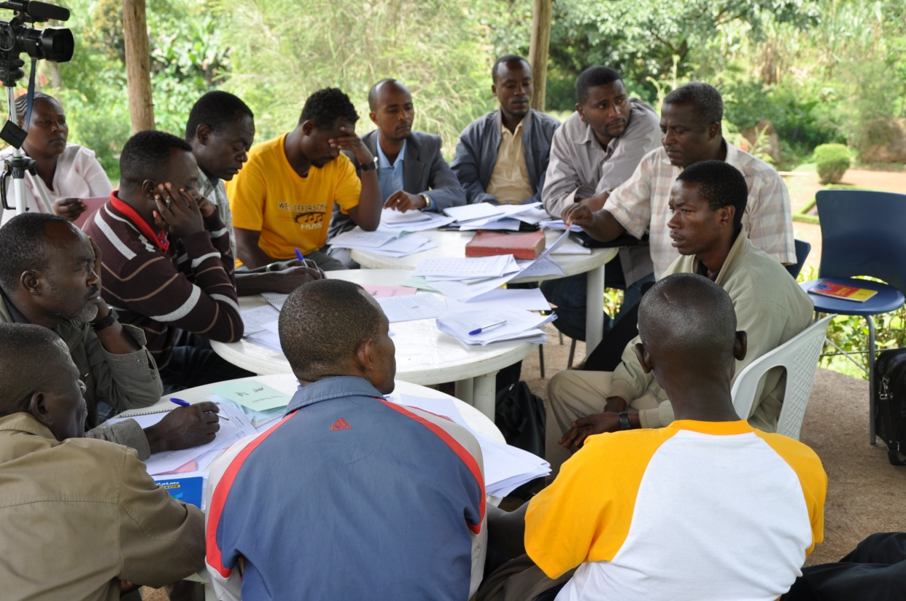
Working Orthography
After thorough testing of the Trial Orthography the result will be presented to the Board of the language community.
they will endorse the necessary changes,
A formal statement defines the official standard for writing the language.

Slide 19
Conclusion
The script choice in the Bench Maji cluster of languages is not the task of linguists or a few individuals or a group of politicians only, rather it is the task and responsibility of every member of the society including those who are not members of the language communities. It is ceremonial, celebratory and it is also a ground breaking experience in connecting the ever unconnected parties together -academics with local literacy teachers, high government officials with the local leaders, everyone is united for a defined common purpose. The language that we speak can be written down like any other language, let us do it together!!

